Slide 1
Secure Data Hiding In Images Using Steganography
CAPSTONE PROJECT
Presented By:
Student Name : SOUGATA SAMANTA
College Name & Department : Guru Nanak Institute of Technology, Electronics and Communication Engineering(ECE)

Slide 2
OUTLINE
Problem Statement
Technology used
Wow factor
End users
Result
Conclusion
Git-hub Link
Future scope

Slide 3
Problem Statement
Problem:
In today’s digital world, data security is a major concern.
Traditional encryption methods can raise suspicion.
There is a need for a method to hide secret messages inside images without noticeable changes.
Solution:
Using steganography, we can hide data within an image while keeping it visually unchanged.

Slide 4
Technology used
Programming Language: Python
Libraries:
cv2 (OpenCV) – for image processing
os – for file handling
Concept Used: Steganography (Hiding text inside an image)

Slide 5
Wow factors
Simple yet powerful technique to hide messages.
No extra storage needed – messages are hidden inside an image itself.
Password-protected decryption, ensuring security.
Real-life applications like watermarking, secure communication, and digital forensics.

Slide 6
End users
Cybersecurity Experts: For secure data transfer.
Journalists & Activists: To share information securely.
General Users: To store sensitive information hidden inside images.
Forensic Experts: For investigations and evidence protection.

Slide 7
Results
Encryption:
The message is embedded into an image.
The image looks unchanged but contains hidden data.
Decryption:
The original message is extracted from the image using the correct passcode.

Slide 8
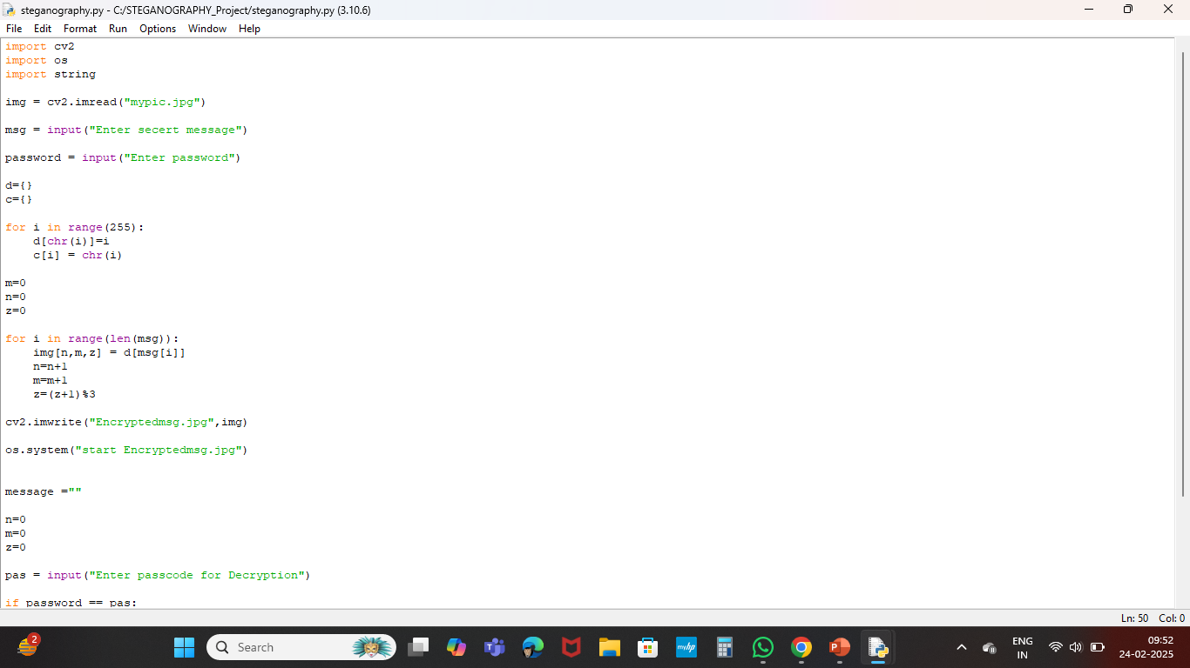
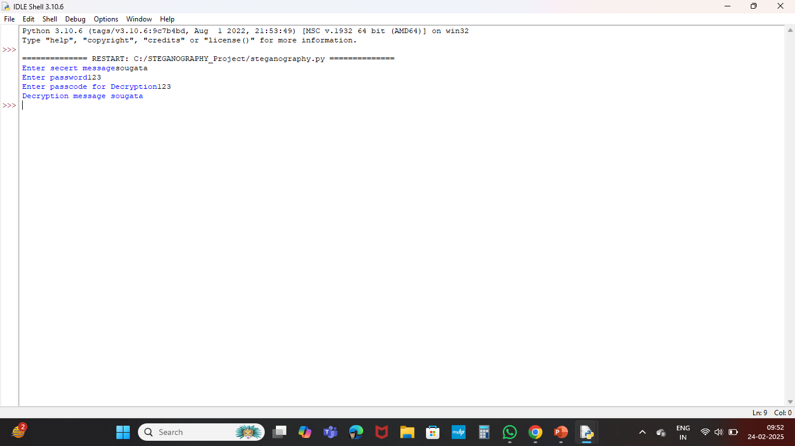
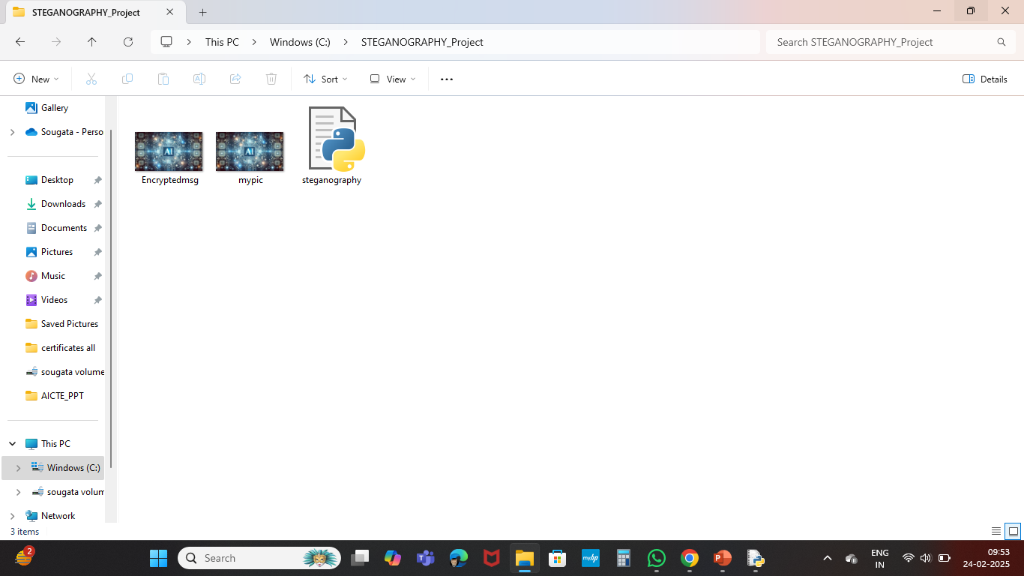
Results

Slide 9
Conclusion
Steganography is an effective method for secure communication.
The project successfully hides and retrieves secret messages inside images.
Future improvements can enhance security using AES encryption before embedding.

Slide 10
GitHub Link
https://github.com/samantasougata/Stenography.git

Slide 11
Future scope
Enhanced Security: Encrypting messages before hiding them.
Support for Multiple Image Formats: PNG, BMP, etc.
Better Compression Techniques: To minimize changes in image quality.
Mobile & Web Integration: Making it a user-friendly tool.

Slide 12
THANK YOU

